Slide 1
FunkMusic: Functional Specialization between Speech and Music in Convolutional Neural Networks
10-ECTS Project, Artificial Intelligence M.Sc.
Presenter: Amin Heydarshahi
Supervisors: Prof. Dr. Bernhard Egger Prof. Dr. Andreas Kist Dr. Katharina Dobs
Summer semester 2023

Slide 2
Outline
Motivation:
Task segregation in brain and neural networks
Background:
Faces and objects in CNNs
Methods:
Words and music in CNNs
Results
Discussion: Is music special to CNNs?
Notes:
I've said task segregation many times
so before we move on, let's have a look at the terminology

Slide 3
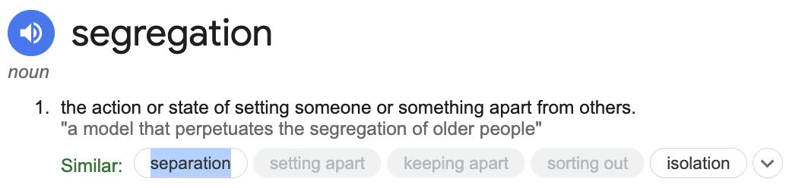
Terminology

Slide 4
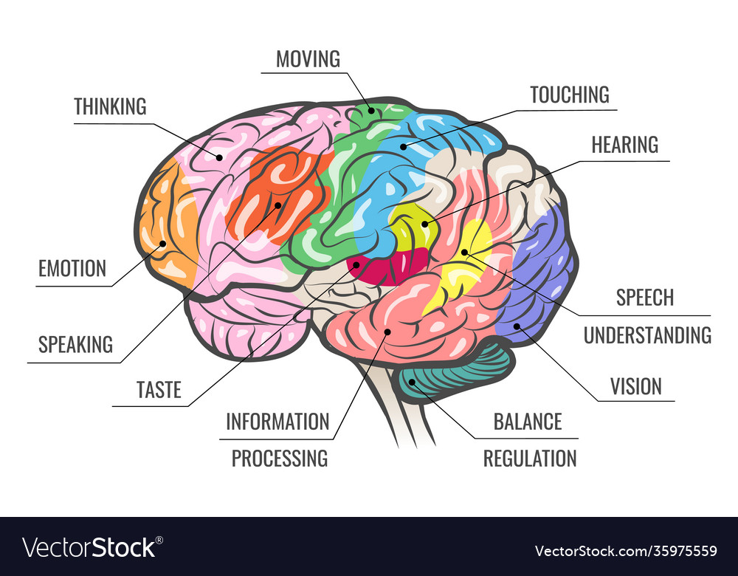
Motivation
Task segregation in the brain
What do you think of when you hear task specialization in the brain?
Notes:
To motivate the presentation
What do you think of when you hear task segregation in the brain?

Slide 5
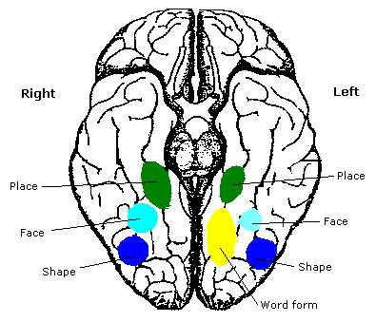
Motivation
Functional specialization in the brain
https://commons.wikimedia.org/wiki/File:Constudproc.png
Notes:
Within each region, there is functional specialization
(FFA) You’ve probably learned this in Bernhard’s lectures

Slide 6
Motivation
Functional specialization in the brain
Why does task segregation happen in the brain?
Why is the task segregation functional?
Does it happen in neural networks?
Notes:
Many questions can be posed now

Slide 7
Motivation
Functional specialization in the brain
Why does task segregation happen in the brain?
Why is the task segregation functional?
Does it happen in neural networks?
Notes:
Many questions can be posed now

Slide 8
Motivation
Functional specialization in the brain
Why does task segregation happen in the brain?
Why is the task segregation functional?
Does it happen in neural networks?
Idea:
Train a CNN with two tasks that are segregated in the brain
Find out if the segregation emerges in the CNN
Notes:
Many questions can be posed now
There has been e number of works
One of the ideas that some of the papers have adopted

Slide 9
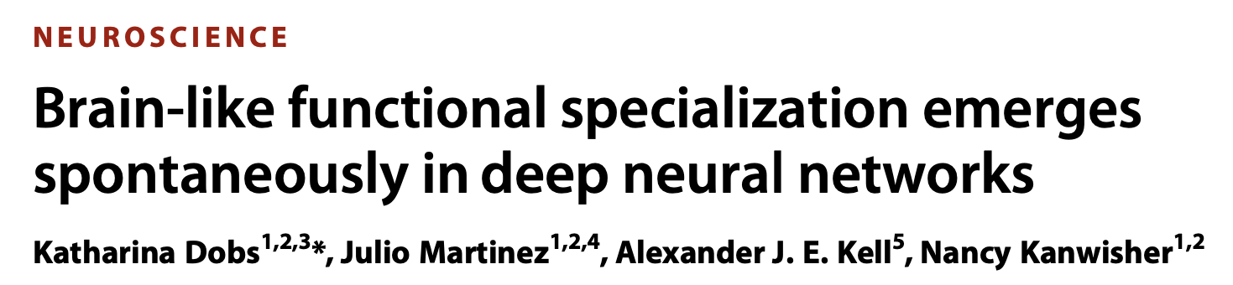
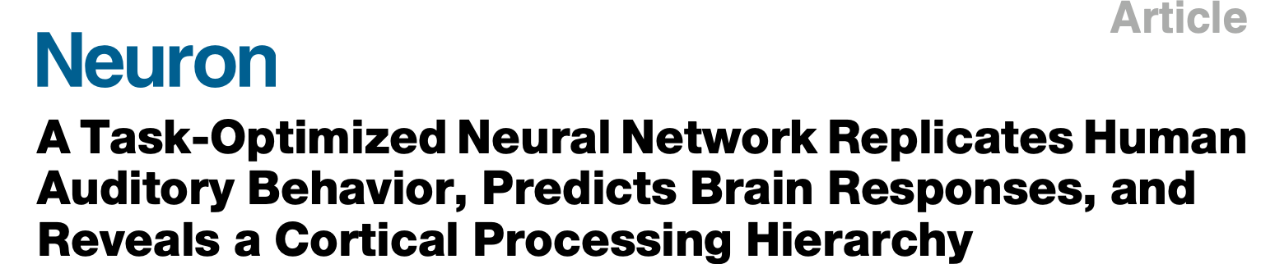
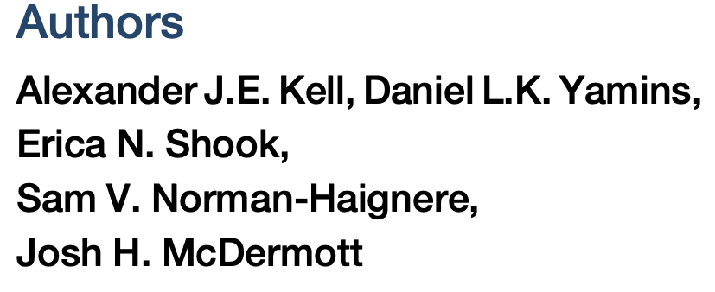
Background
Task segregation in CNNs
Faces vs. Objects
Words vs. Music
Notes:
There have been many interesting attempts to approach these problems
1. I will call this the source paper | face paper | Katharina’s paper
2. This is target paper | music paper

Slide 10
Background
Task segregation in CNNs
Faces vs. Objects
Words vs. Music
Notes:
There have been many interesting attempts to approach these problems
1. I will call this the face paper | Katharina’s paper
2. This is music paper
Let's start with the face paper

Slide 11
Background: Face Paper
Why is the brain specialized functionally?
Random byproduct of evolution
Modularity approach: brain is “modulated” into different regions that talk to each other if necessary
Computational reasons cause the brain to find domain-specific representations
Notes:
Many possible answers...
They make the case that the functional segregation comes from computational reasona:
If CNNs show this behavior, it supports the hypothesis that this can be attributed to an optimization that's happening in the brain

Slide 12
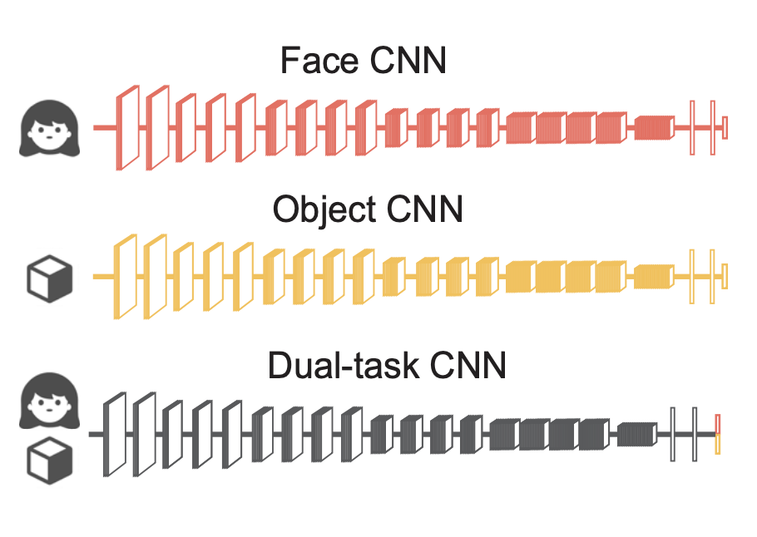
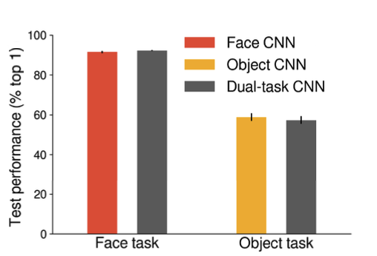
Background: Face Paper
How to measure task segregation in CNNs?
Train a CNN on faces
Train a CNN on objects
Train a dual CNN on both datasets
Compute accuracies
Detect neurons responsible for one task in dual-task CNN
Notes:
First interesting result --> dual task can perform as well as single task nets
But what does it have to do with task segregation?
I'll provide more details about what it means "responsible" means

Slide 13
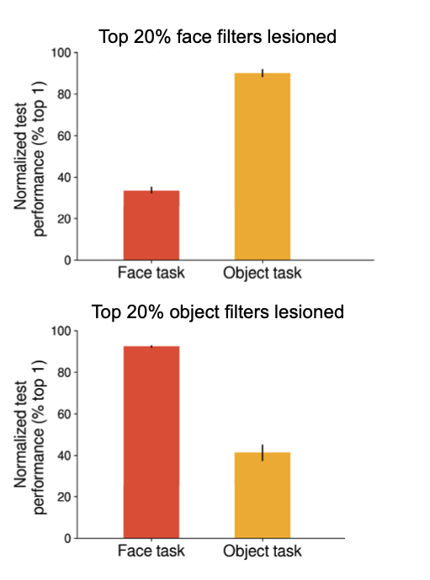
Background: Face Paper
How to measure task segregation in CNNs?
Detect neurons responsible for one task in dual-task CNN
Lesioning Experiment Lesion (disable) them and observe the effect on the other task
Idea of this project: do the lesioning experiment on words and music
Notes:
Face --> Expected
Object --> means CNN hasn't learned a SHARED REPRESENTATION
Doesn’t the music paper do this?

Slide 14
Background
Overview of the experiments
 | Face Paper | Music Paper | This Project
Dual-task CNNs | ✔️ | ✔️ | ✔️
Lesioning Experiments | ✔️ | 𝘟 | ✔️
Batching Method | Mixed | Non-mixed | Mixed and Non-mixed
Branched CNNs | ✔️ | ✔️ | 𝘟
Comparison to human responses | ✔️ | ✔️ | 𝘟
Notes:
I will get into more details about batching methods

Slide 15
Background
Overview of the experiments
 | Face Paper | Music Paper | This Project
Dual-task CNNs | ✔️ | ✔️ | ✔️
Lesioning Experiments | ✔️ | 𝘟 | ✔️
Batching Method | Mixed | Non-mixed | Mixed and Non-mixed
Branched CNNs | ✔️ | ✔️ | 𝘟
Comparison to human responses | ✔️ | ✔️ | 𝘟

Slide 16
Methods: Experiment Design
Outline of our experiments on words and music
Create music and word datasets
Train music, word, and dual-task CNNs
Experiment 1: Compare performance with mixed vs. non-mixed batches
Experiment 2: Do the lesioning experiment on words and music CNNs

Slide 17

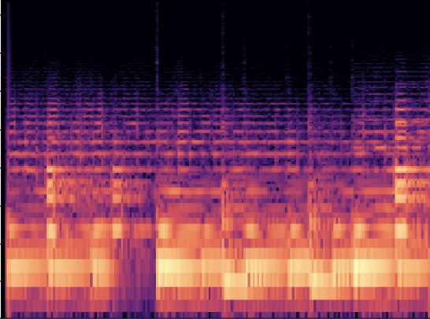
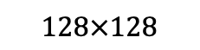
Methods: Word Dataset
Task: spoken word classification → 467 words
Start from Common Voice Dataset with spoken sentences
Find most frequent 467 words
Crop audio files to 2-second clips containing these words
Get mel-spectrogram features from the waveforms
A street and a square are named after him.
$$128×128$$
Notes:
Let's talk datasets

Slide 18
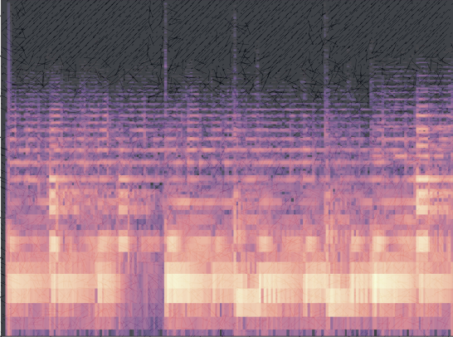
Methods: Music Dataset
Task: genre classification → 61 genres
Start from MTG-Jamendo Dataset with music tracks
Randomly crop audio files to 2-second clips
Get mel-spectrogram features from the waveforms
Pop
$$128×128$$

Slide 19
Methods: Dataset Details
Word Dataset
Music Dataset
467 word classes
400-4000 samples per class
~900,000 total samples
61 genre classes
15000 samples per class
~900,000 total samples

Slide 20
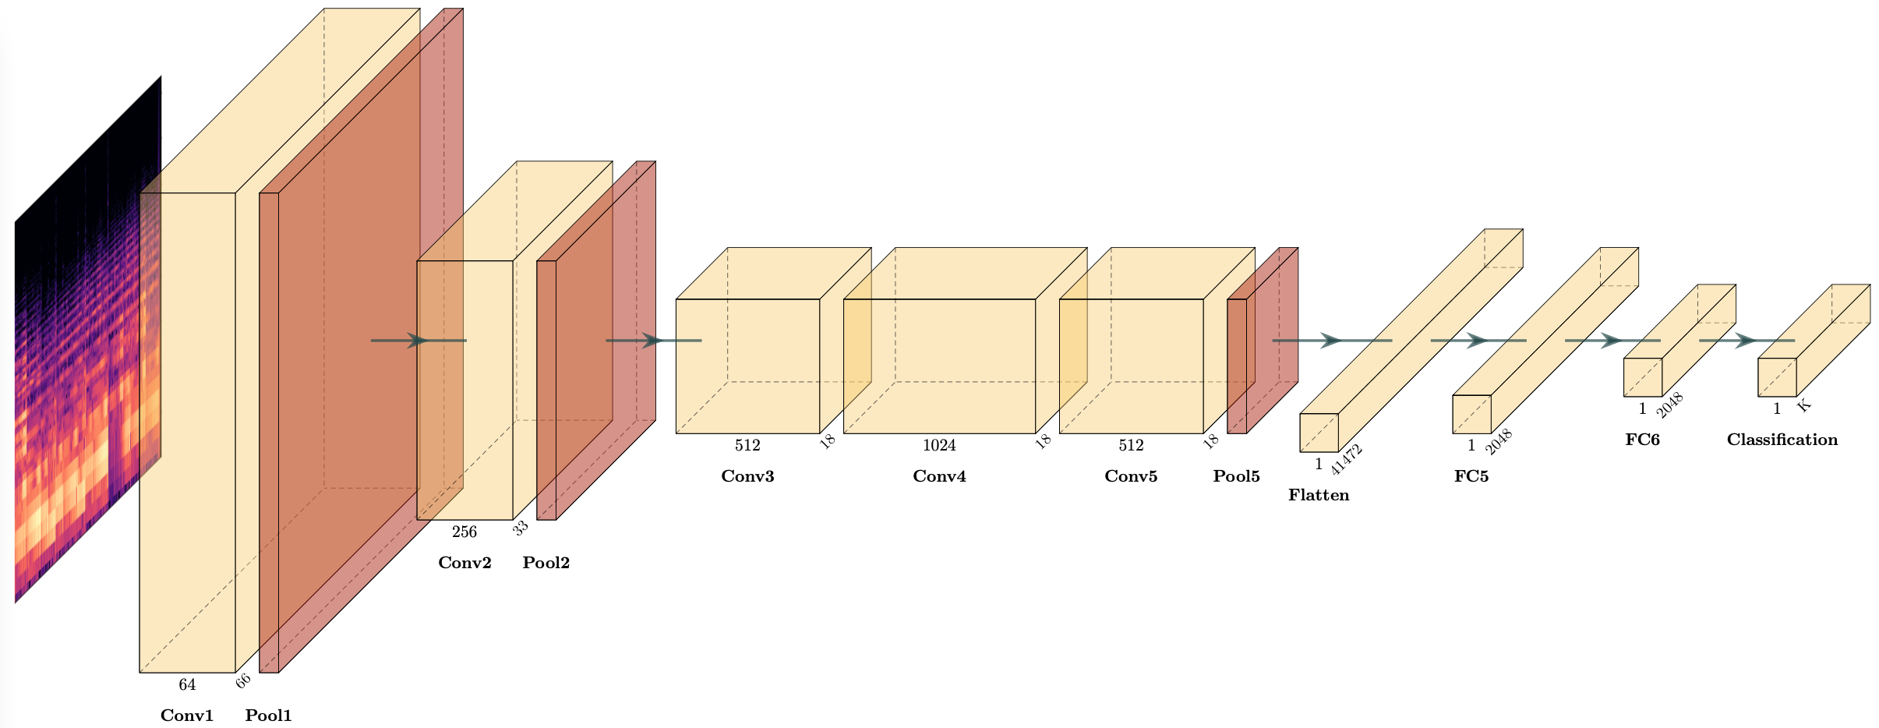
Methods: CNN Architectures
AlexNet

Slide 21
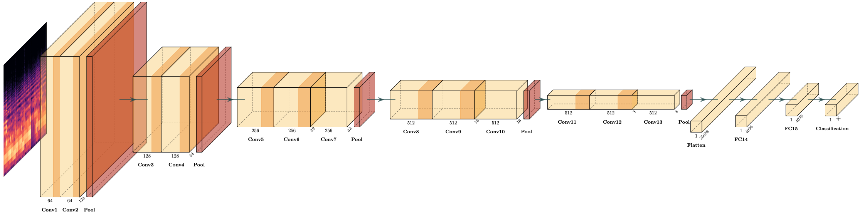
Methods: CNN Architectures
VGG-16

Slide 22
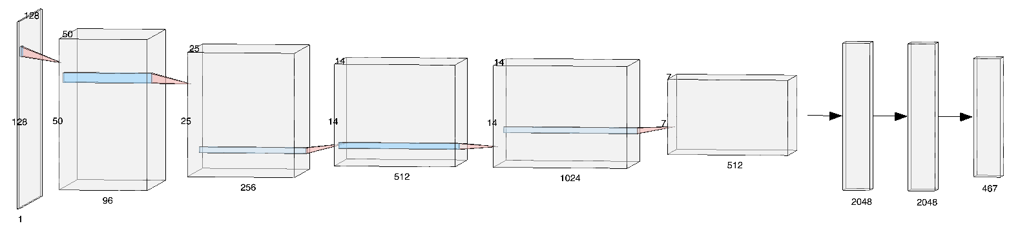
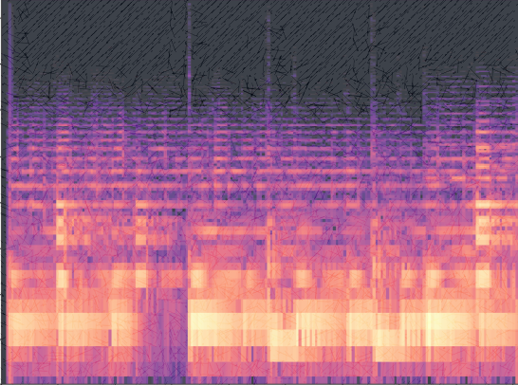
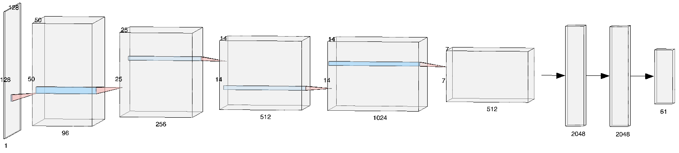
Methods: Single Tasks
Word task
Music task
street
pop

Slide 23
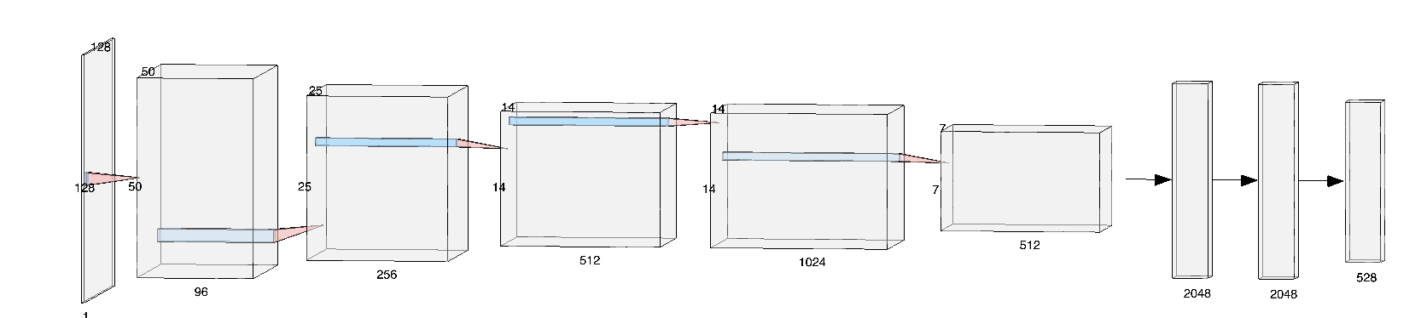
Methods: Dual Task
Dual task with non-mixed batches
street
pop

Slide 24
Methods: Mixed and Non-mixed Batches
Dual task with non-mixed batches
Dual task with mixed batches
Notes:
This setting is used in the music paper.
Mixed batches are more intuitive and similar to how humans learn

Slide 25
Methods: Dual-task CNNs
Dual task with non-mixed batches
Dual task with mixed batches
Notes:
The idea --> in a single update of the network, both types of data are seen by the network

Slide 26
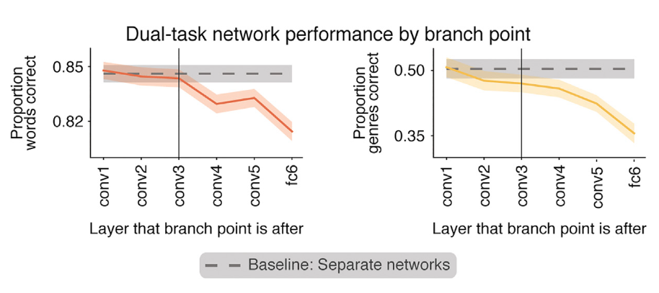
Methods: Mixed and Non-mixed Batches
Why do we care about the batches?
Music paper reports a drop in fully-shared dual network compared to music- and word networks
Face paper does not show this performance drop
Maybe with mixed batches, this drop is mitigated
Notes:
If time is running, skip this

Slide 27
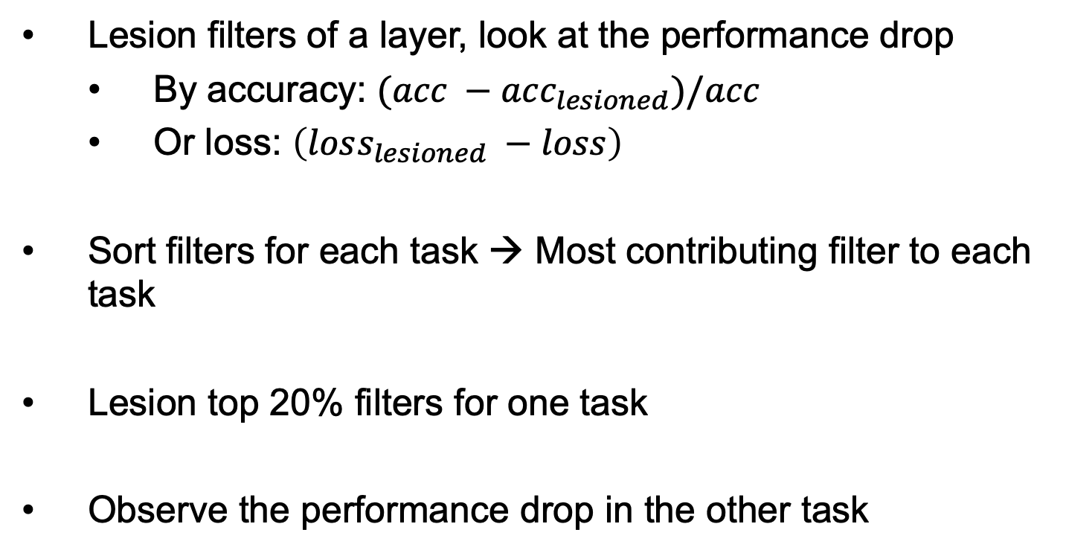
Methods: Lesioning Experiment
In the dual network:
Lesion filters of a layer, look at the performance drop
By accuracy: $(acc −acc_{lesioned})/acc$
Or loss: $\left(loss_{lesioned} −loss\right)$
Sort filters for each task → Most contributing filter to each task
Lesion top 20% filters for one task
Observe the performance drop in the other task
Notes:
One by one

Slide 28
Results
Mixed vs. non-mixed training in AlexNet (no lesioning)
Notes:
top-5 accuracy
non-mixed needed more hyperparameter tuning

Slide 29
Results
Mixed vs. Non-mixed Training in Alexnet
Fully shared dual network can perform on par with single netwoks
Both mixed and non-mixed dual nets approached the same accuracy
During training, mixed-batch network was less prone to overfitting
With VGG-16, mixed training was more robust to overfitting than non-mixed training

Slide 30
Results
VGG-16 overfits with non-mixed batches but not with mixed training

Slide 31
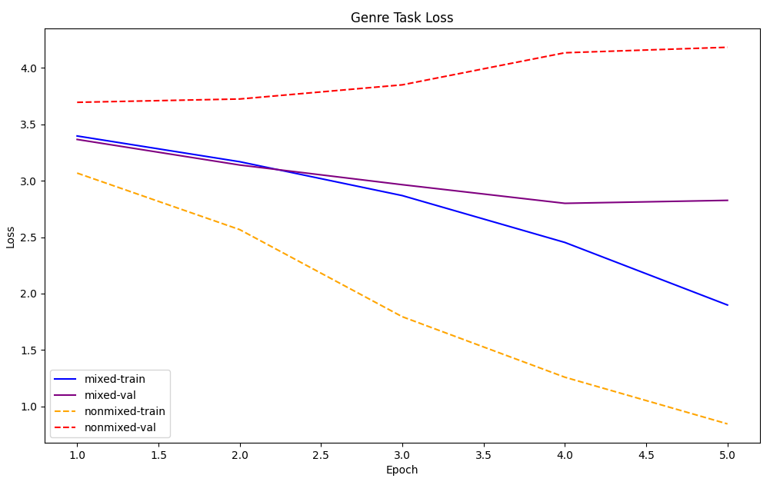
Results
Overfitting with non-mixed training in VGG-Net

Slide 32
Results
VGG-16 overfits with non-mixed batches but not with mixed training

Slide 33
Results: Lesioning Experiment
Lesioning experiment on non-mixed AlexNet

Slide 34
Results: Lesioning Experiment
Lesioning experiment on mixed Alexnet

Slide 35
Results: Lesioning Experiment
Lesioning experiment on non-mixed VGG-16

Slide 36
Results: Lesioning Experiment
Lesioning experiment on mixed VGG

Slide 37
Results
Conclusions
Mixed training performs the same as non-mixed same on AlexNet
But surpasses non-mixed training on VGG-16
Mixed training prevents overfitting in VGG-16
Task segregation is stronger in non-mixed models

Slide 38
Discussion
Future Directions
Ablation studies for the lesion experiments
Different dataset features
Branched networks
Batch normalization
Other pairs of task

Slide 39
Discussion
Challenges
Dataset used in the music paper was not publicly available
Creating new balanced reliable datasets
Incorporating own code into authors’ code

Slide 40
Discussion
Contributions
Melspec dataset of music genre classification
Code to generate different variations of the data
Dataset of spoken words using Common Voice Dataset
Code to experiment with dual-task networks
Observing effect of using mixed- vs. non-mixed batches in dual-task training

Slide 41
References
[1] Dobs, Katharina, et al. "Brain-like functional specialization emerges spontaneously in deep neural networks." Science advances 8.11 (2022): eabl8913.
[2] Kell, A. J., Yamins, D. L., Shook, E. N., Norman-Haignere, S. V., & McDermott, J. H. (2018). A task-optimized neural network replicates human auditory behavior, predicts brain responses, and reveals a cortical processing hierarchy. Neuron, 98(3), 630-644.
[3] Norman-Haignere, S. V., Feather, J., Boebinger, D., Brunner, P., Ritaccio, A., McDermott, J. H., ... & Kanwisher, N. (2022). A neural population selective for song in human auditory cortex. Current Biology, 32(7), 1470-1484.
[4] Boebinger, D. L., Norman-Haignere, S. V., McDermott, J. H., & Kanwisher, N. G. (2021). Music-selective cortex is sensitive to structure in both pitch and time. bioRxiv, 2021-12.
Notes:
Thank supervisors

